Slide 1

S07
Kia Babashahi Ashtiani

Slide 2
Outline
Casting
Logic
Logical operators in programming
Precedence of logical operators.
Math classes and packages
Introduction to control statements.

Slide 3
Casting
You can convert some types to the other.
A much more in-depth explanation will be provided eventually.

Slide 4
Int to double casting.
Some types are easier to cast to the other.
When dividing 3 by 2 you expect to see 1.5. Yet, as you have seen if you divide an integer by another integer the result will remain an integer.
What can be done?

Slide 5

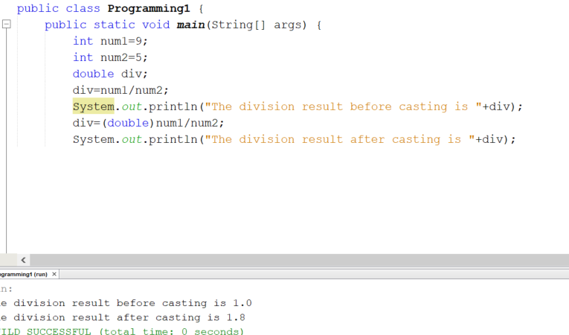
Casting example

Slide 6
Logic
Maybe the first concept in mathematics.
Everything we do in math has some relationship with logic.
Human interaction.
Deals with reasoning.
Once you learn it and love it, your life will not be the same any more.

Slide 7
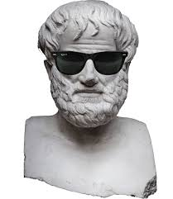
History
Aristotle
Gottlob frege
Kurt Godel

Slide 8
Similar to human language
A proposition is a declarative statement that is either true or false.
These slides have been prepared by a human. TRUE
2+3=5 TRUE
2+2=9 FALSE
The earth is flat: FALSE!

Slide 9
Logical Operations
Conditional: If it rains, I will bring my umbrella.
And : I will pick up the kids and cook dinner.
Or: I will go to see Kevin or Justin. (You could visit both).
Exclusive OR( XOR) : I will either go see Kevin or Justin.

Slide 10
Truth Tables
2+2=4 is called a proposition. Let's rename it to p:
It is not the case that 2+2=4 is shown by ~p or in programming !p
p
T
F
p | !p
T | F
F | T

Slide 11
Binary operators
P | Q | P -> Q (If p then q) | P && Q (And) | P || Q (Or)
T | T | T | T | T
T | F | F | F | T
F | T | T | F | T
F | F | T | F | F

Slide 12
These operators are applied on
Boolean variables: Boolean Algebra
Zero and one.

Slide 13
Usage
In the future you will embed them in control statements.
For now you will apply them to normal

Slide 14
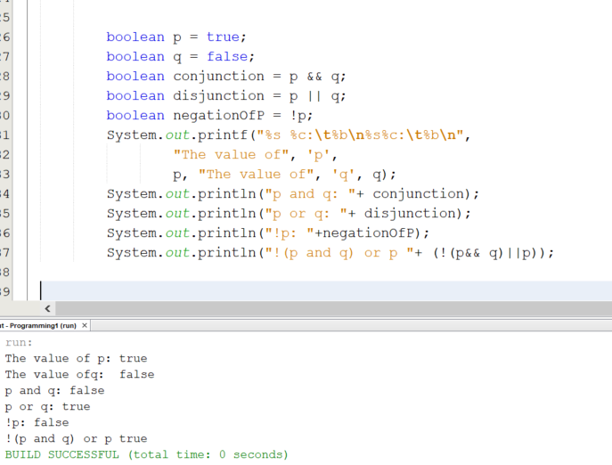
Code

Slide 15
Precedence of operators
For now first compute what is inside of the parenthesize until you are taught actual propositional and predicate logic ☺

Slide 16
Important packages
As programmers you need to feel comfortable using packages and libraries.
Some static methods(functions) have been integrated in some Java packages that you can use.
These methods (functions) have been implemented very efficiently and are of static nature so no need to create an object of them just load them in the memory.

Slide 17
Static methods and class
When a method does something independent of the content of any objects.
Import the package, call the methods and work with them.
First address the first name then call the method.
Dog.catch(Ball);

Slide 18
Math class
Provides you with a list of methods that you can use for a lot of mathematical operations.
Examples: Min(), Max (), Sin(theta),Cos(Theta), Floor(), Ceil(), ABS(),…. .

Slide 19
Methods or functions
We will talk about methods and functions in much more detail in a few classes.
Similar to what you have seen in math.
A function has a name, and it receives arguments and it can return something.
f(x)=2x+1:
f(2)=5
f is the name of the function, 2 is the input and 5 is what is returned (pay attention it is an int in this example)

Slide 20
More on methods
What are you using the method for?
What are your input parameters? What is their type?
What is the type of your output?

Slide 21
Methods
Method name | What it does
max(x,y) | Max of two numbers
min(x,y) | Min of two numbers
abs(x) | The absolute value of x
log(x) | finds the base e logarithm of x
cos(x) | Computes the cosine of x in radians
sin(x) | Computes the sine of x in radians
tan(x,y) | Computes the tangent of x in radians
floor(x) | Rounds x down to the next smallest integer
ceil(x) | Rounds x up to the next largest integer

Slide 22
Methods continued
Method’s name | What it does
pow(x,y) | Raises x to the power of y
exp(x) | Raises e to the power of x (exponent method)
sqrt(x) | Computes the square root of a positive number x

Slide 23
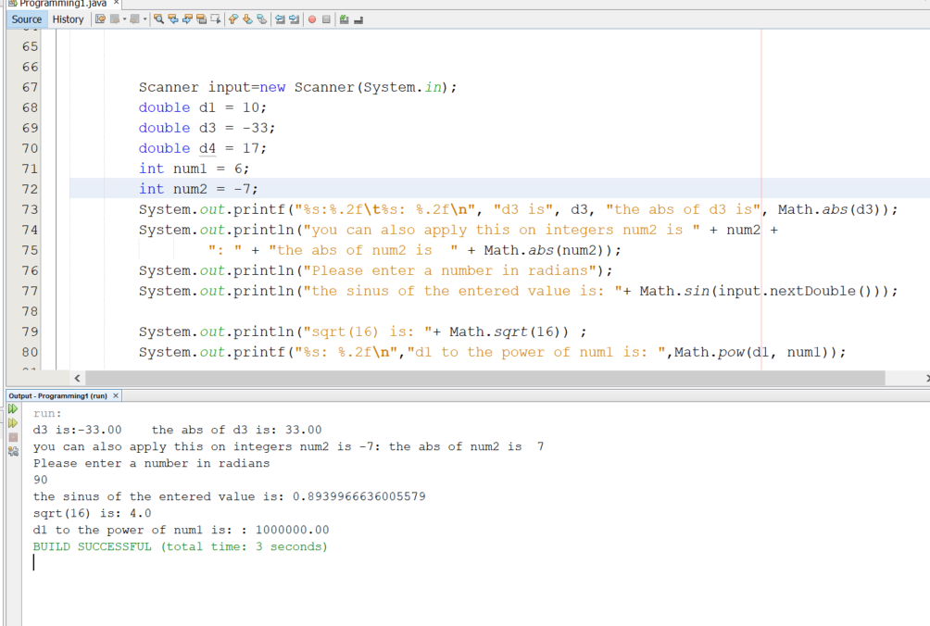
Example

Slide 24
Methods have been loaded
The methods of the math class have been already imported in java.lang which you normally do not need to call.
There are multiple methods with the same name but different parameters that is called method overloading. We will discuss this in the future.

Slide 25
Random
A very important package.
Generate random numbers.
Technically it is not really random. It is called a pseudo random generator.
Almost random.

Slide 26
Random numbers in Java
When generating a random number:
Specify the type: Integer, Double,….
Specify
Your upper bound(range) EXP: randNum.nextInt(10);
A Shift. EXP: 6+ randNum.nextInt(10);

Slide 27
Random numbers
The range will generate a number between zero and what is in the parenthesize.
The shift will give you a different starting point than zero.

Slide 28
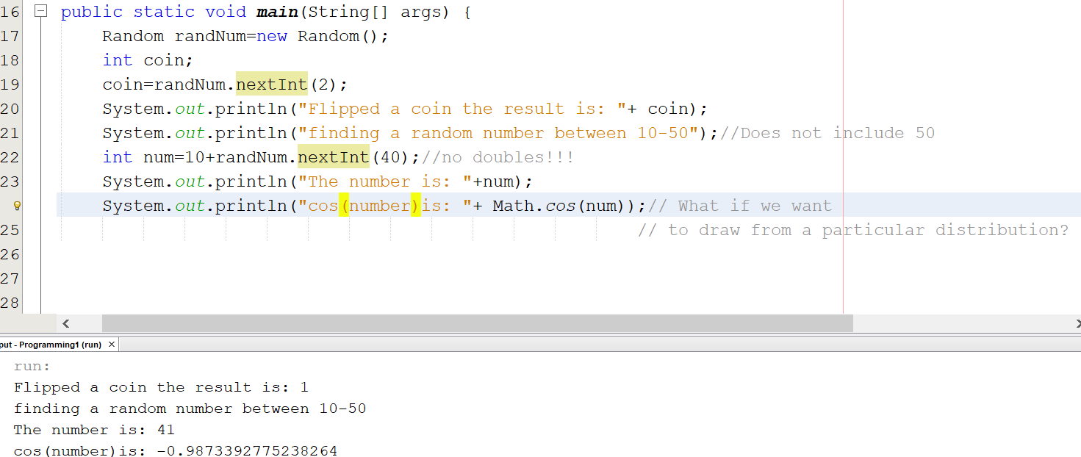
Example
What if you want to

Slide 29
Next time
Casting
Control statements

Slide 30
References
Ditel & Ditel,2012, Java how to program 9th edition, Pearson education .

